Slide 1
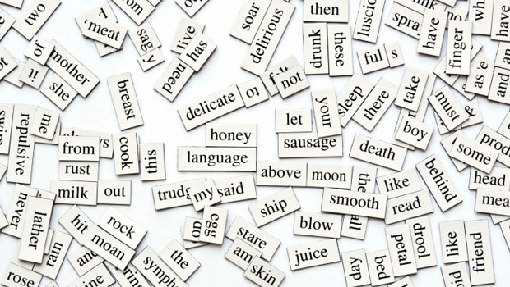
Parts of Speech

Slide 2
what
are
the
PARTS
of
SPEECH
?
?

Slide 3
NOUNS

Slide 4
NOUNS
ADJECTIVES

Slide 5
NOUNS
ADJECTIVES
PRONOUNS

Slide 6
NOUNS
ADJECTIVES
PRONOUNS
VERBS

Slide 7
NOUNS
ADJECTIVES
PRONOUNS
VERBS
ADVERBS

Slide 8
NOUNS
ADJECTIVES
PRONOUNS
VERBS
ADVERBS
PREPOSITIONS

Slide 9
NOUNS
ADJECTIVES
PRONOUNS
VERBS
ADVERBS
PREPOSITIONS
CONJUNCTIONS

Slide 10
NOUNS
ADJECTIVES
PRONOUNS
VERBS
ADVERBS
PREPOSITIONS
CONJUNCTIONS
INTERJECTIONS

Slide 11
INTERJECTIONS
Single words that convey an emotive response

Slide 12
INTERJECTIONS
Meh.
Phew…
Wow!
Oh?
YES!
No?
Ah!
Humph.
Ewww…
Awww...
Eureka!
$#@%&!!!!

Slide 13
NOUNS
Person
Place
Thing

Slide 14
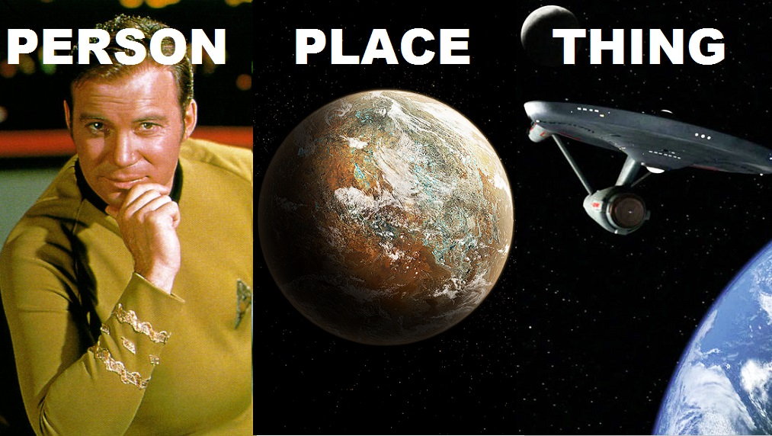

Slide 15
NOUNS
Common
Nouns
Proper
Nouns

Slide 16
COMMON NOUNS | PROPER NOUNS
Generic words that signify all nouns of the same category | Are a specific/proper name
Can be plural or singular (ex. leaf or leaves) | Are usually singular (ex. Portugal, Sephora)
Only capitalized at the beginning of a sentence | Are always capitalized

Slide 17
VERBS
Action
Occurrence
State of being

Slide 18
VERBS
Tenses
Subject-Verb
Agreement

Slide 19
SUBJECT-VERB AGREEMENT
Singular Noun; Singular Verb
A kleptomaniac takes things literally.

Slide 20
SUBJECT-VERB AGREEMENT
Plural Noun; Plural Verb
Whiteboards are remarkable.

Slide 21
SUBJECT-VERB AGREEMENT
Two (or more) Objects = Plural
The past, present, and future walk into a bar. It is tense.

Slide 22
SUBJECT-VERB AGREEMENT
The verb must agree with the subject,
NOT the prepositional phrase.
The engineers on the train were not electrocuted because they were not conductors.

Slide 23
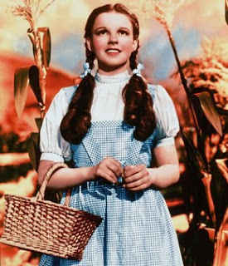
HERE AND THERE: Subject Complements
Describing a Singular Noun
“There is no place like home.”

Slide 24
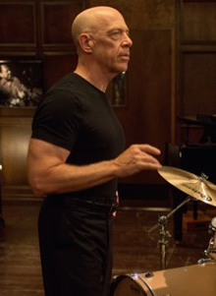
SUBJECT COMPLEMENTS
Describing a Plural Noun
“There are no two words in the English language more harmful than ‘good job.’”

Slide 25
COLLECTIVE NOUNS
Britain
United States & Canada
The group are upset that Zayn left.
The group is upset that Zayn left.

Slide 26


Slide 27
ADJECTIVES
Describing words
They restrict or qualify nouns or noun phrases

Slide 28
ARTICLES
are
ADJECTIVES

Slide 29
Type of Noun | Indefinite | Definite
Singular | Use ‘a’ or ‘an’. Example: “I’m going to make him an offer he can’t refuse.” | Use ‘the’ Example: “May the Force be with you.”
Plural | No article. Example: “I see dead people.” | Use ‘the’ Example: “Round up the usual suspects.”
Uncountable | No article. Example: “With great power comes great responsibility.” | Use ‘the’ Example: “I have always depended on the kindness of strangers.”

Slide 30
ORDERING ADJECTIVES
Articles
Quantity
Opinion
Size
Age
Shape
Colour
Origin
Material
Purpose

Slide 32
PRONOUNS
Function as nouns
Replace or refer to nouns

Slide 33
PERSPECTIVE | NUMBER | SUBJECT | OBJECT
FIRST | SINGULAR | I | ME
 | PLURAL | WE | US
SECOND | SINGULAR | YOU
THIRD | SINGULAR | HE | HIM
 |  | SHE | HER
 |  | IT
 | PLURAL | THEY | THEM
 | SINGULAR | WHO | WHOM

Slide 34
PRONOUN EXAMPLES
“I don’t want to be part of a club that would have me as a member.” – Groucho Marx
“I have a friend. He keeps trying to convince me that he is a compulsive liar, but I don’t believe him.” – Ben Bailey
“She wanted a puppy; I didn't. We compromised, and I bought her a puppy.” – Unknown
“They tell me that I am condescending. That means I talk down to them.“– Unknown.

Slide 35
POSSESSIVE PRONOUNS
VS.
POSSESSIVE ADJECTIVES

Slide 36
POSSESSIVE PRONOUN | POSSESSIVE ADJECTIVES
MINE | MY
OURS | OUR
YOURS | YOUR
HERS | HER
HIS | HIS
THEIRS | THEIR
ITS | ITS
WHOSE | WHOSE

Slide 37
EXAMPLES
I lost my toothbrush. Can I borrow yours?
Our presentation was awful, but theirs was amazing.
You ate your cake; I’m saving mine for later.
I gave her my phone number, but she wouldn’t give me hers.

Slide 39
ADVERBS
Describe verbs
Describe adjectives
Describe other adverbs

Slide 40
Where do ADVERBS go?
Firstly, they can go at the beginning of the sentence.
People often put them before the verb for emphasis.
They can likewise go in between verbs.
They can be placed immediately after a verb.
Lastly, they can conclude a sentence definitively.
There are few specific rules to guide this choice, so read the phrase out loud and see what sounds best.

Slide 41


Split Infinitive?
To boldly go where no one has gone before.

Slide 42
VERY, REALLY, EXTREMELY
It is very hot!
It is really cold!
I am extremely hungry!

Slide 43
VERY, REALLY, EXTREMELY
It is boiling!
It is really cold!
I am extremely hungry!

Slide 44
VERY, REALLY, EXTREMELY
It is boiling!
It is freezing!
I am extremely hungry!

Slide 45
VERY, REALLY, EXTREMELY
It is boiling!
It is freezing!
I am starving!

Slide 46
CONJUNCTIONS
Link clauses
Link phrases
Link words

Slide 47


Slide 48
CONJUNCTIONS
Coordinating
Correlating
Subordinating

Slide 49

Coordinators: Examples
F For (explains why)
A And (addition)
N Nor (excludes)
B But (disagree/contrast)
O Or (alternative)
Y Yet (disagree/contrast)
S So (consequence)

Slide 50
Coordinating Conjunctions
Lists
Phrases
Clauses

Slide 51
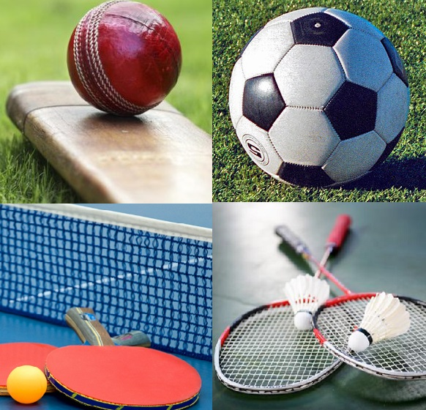
Lists
We can go play cricket, soccer, ping pong, or badminton.

Slide 52
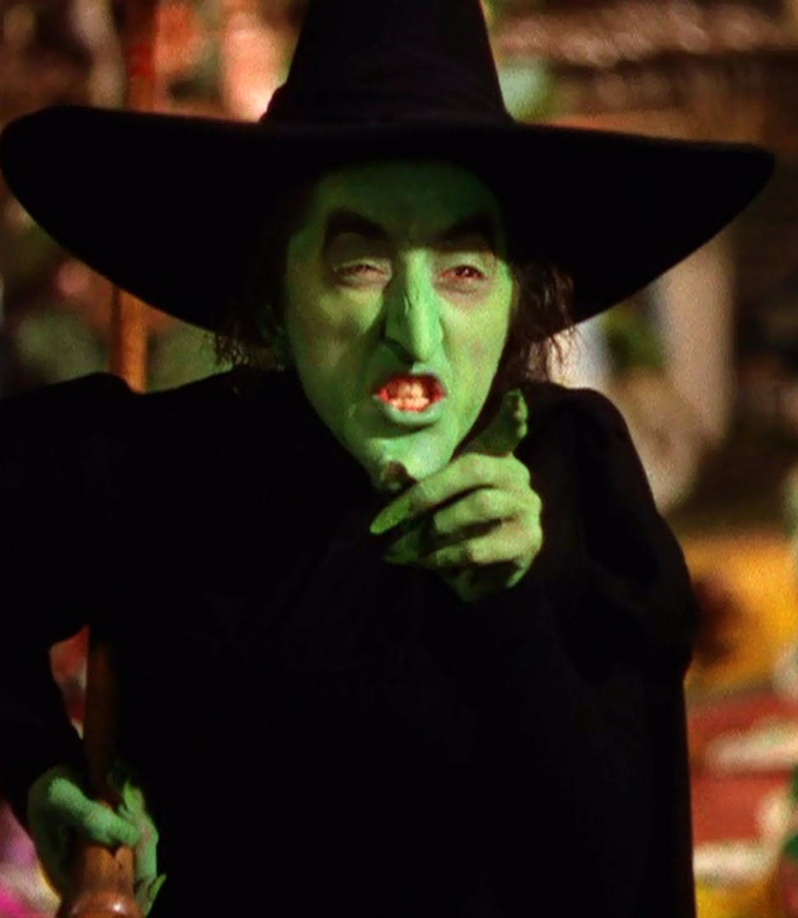
Phrases
“I’ll get you, my pretty, and your little dog too!”

Slide 53
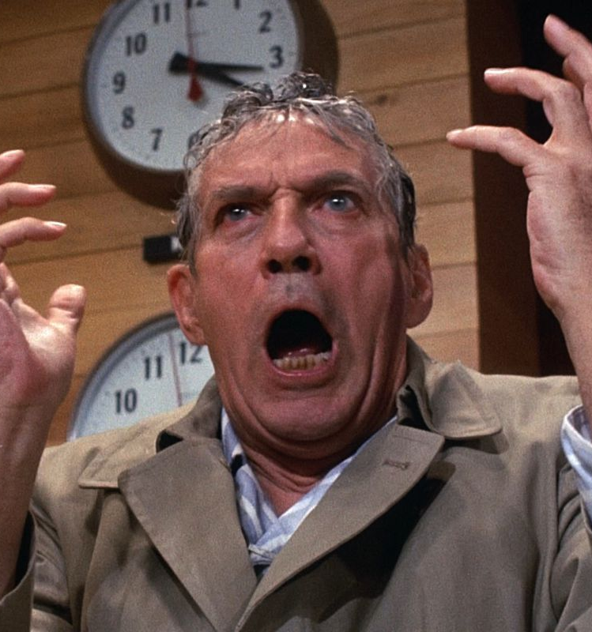
Clauses
“I'm as mad as hell, and I'm not going to take this anymore!”

Slide 54
Subordinating Conjunctions
Preceding
Concluding

Slide 55
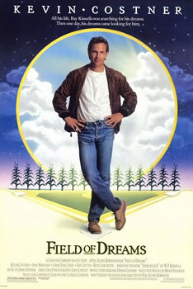
Precediing
“If you build it, they will come.”

Slide 56

Concluding
“There will be generations because of what you did.”

Slide 57
Correlating Conjunctions
Correlating conjunctions links pairs of words within a sentence and frames them as equally important.
either... or
neither... nor
whether... or
just as... so
as... as
as much... as
no sooner... than

Slide 58

Example
“Your scientists were so preoccupied with whether or not they could, they didn’t stop to think if they should.”

Slide 59
‘WHICH’ & ‘THAT’
RELATIVE CLAUSE
RESTRICTIVE CLAUSE
I just saw Police Story, which stars Jackie Chan.
I just saw a police film that stars Jackie Chan.

Slide 60
‘WHO’ & ‘WHO’
RELATIVE CLAUSE
RESTRICTIVE CLAUSE
I just met Jackie Chan, who is the star of Police Story.
I just met the actor who is the star of Police Story.

Slide 61
PREPOSITIONS
Show temporal and spatial relationships between nouns and other parts of a sentence

Slide 62
CONFUSING?
I visited China __ 2018.
I visited China __ March.
I went to Toronto __ March 21st.
I went to the mall __ 12:00.
I went to the mall __ the morning.
I went to the mall __ night.
I went to the mall __ the evening.

Slide 63
CONFUSING?
I visited China in 2018.
I visited China __ March.
I went to Toronto __ March 21st.
I went to the mall __ 12:00.
I went to the mall __ the morning.
I went to the mall __ night.
I went to the mall __ the evening.

Slide 64
CONFUSING?
I visited China in 2018.
I visited China in March.
I went to Toronto __ March 21st.
I went to the mall __ 12:00.
I went to the mall __ the morning.
I went to the mall __ night.
I went to the mall __ the evening.

Slide 65
CONFUSING?
I visited China in 2018.
I visited China in March.
I went to Toronto on March 21st.
I went to the mall __ 12:00.
I went to the mall __ the morning.
I went to the mall __ night.
I went to the mall __ the evening.

Slide 66
CONFUSING?
I visited China in 2018.
I visited China in March.
I went to Toronto on March 21st.
I went to the mall at 12:00.
I went to the mall __ the morning.
I went to the mall __ night.
I went to the mall __ the evening.

Slide 67
CONFUSING?
I visited China in 2018.
I visited China in March.
I went to Toronto on March 21st.
I went to the mall at 12:00.
I went to the mall in the morning.
I went to the mall __ night.
I went to the mall __ the evening.

Slide 68
CONFUSING?
I visited China in 2018.
I visited China in March.
I went to Toronto on March 21st.
I went to the mall at 12:00.
I went to the mall in the morning.
I went to the mall at night.
I went to the mall __ the evening.

Slide 69
CONFUSING?
I visited China in 2018.
I visited China in March.
I went to Toronto on March 21st.
I went to the mall at 12:00.
I went to the mall in the morning.
I went to the mall at night.
I went to the mall in the evening.

Slide 70
PREPOSITION
Single word
Two-word combinations
Prepositional phrases

Slide 71
Temporal Relationships
Before Prior to Leading up to In advance of Ahead of By | During At that time As soon as Throughout | After Following Since

Slide 72
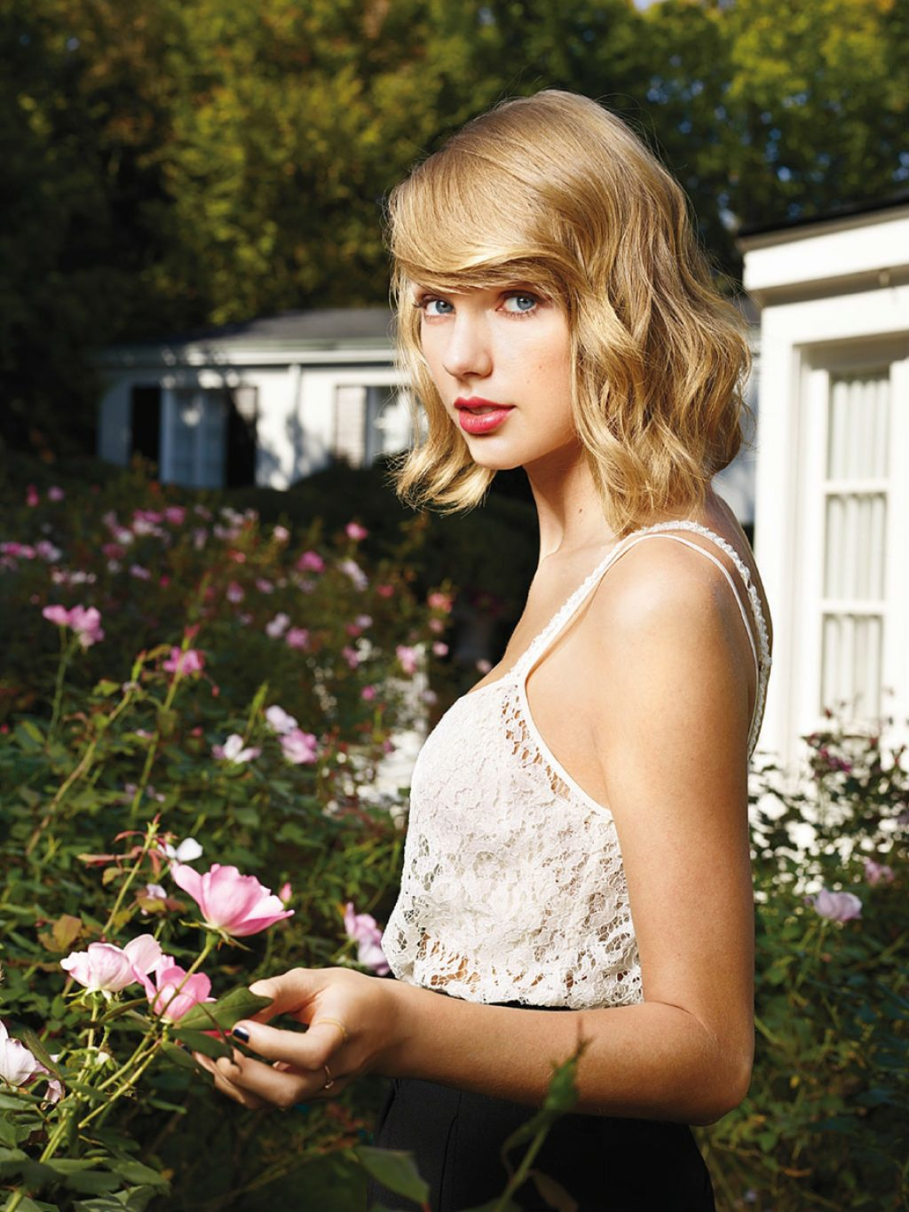
Examples
Taylor dated Joe Jonas and Taylor Lautner before she dated John Mayer.
She dated Eddie Redmayne, Zach Efron, and Tom Hiddleston after John Mayer.
She was feuding with Katy Perry at the same time.

Slide 73
Spatial Relationships
In Within On Above Behind Before In front of Out | Without Above Over Overhead Beyond On top of Beside Next to | Alongside Side by each Side by side Adjacent to Below Under Underneath Beneath

Slide 74
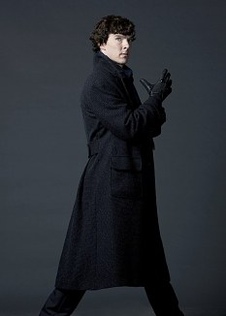
Example
Sherlock was walking around the crime scene when he stepped on a piece of evidence. He picked it up, looked at it, and then put it in his pocket. After turning his thoughts to the evidence, he solved the crime.

Slide 75
Conclusion
NOUN: person, place, or thing
PRONOUN: Refers to and replaces a noun
VERB: action, occurrence, state
ADJECTIVE: describes a noun
ADVERB: describes a verb, adjective or adverb
CONJUNCTION: Links nouns, phrases and clauses
PREPOSITION: Connects a noun to others parts of a sentence
INTERJECTION: A single word that conveys emotion

Slide 76
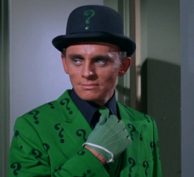
QUESTIONS?

